Slide 1
CMAC 3990.200
Systems Administration and Operations
Fall 2025 – Week 9.1 – October 21st, 2025
Updates and Containers

Slide 2

Objectives
Weekly Info
  Remainder of the semester…
  Reviews
  Project Info
Documentation
  What to document
  Keys to getting started
  Tools to assist in documentation
  Documentation types and locations
  IT Information Library
  Making things repeatable
  Process Mapping
Monitoring
  Historical monitoring
  Real-time monitoring
  Examples
Change Management
  Communication
  Planning & process
  Significance & risk
  Scheduling
Containers
  Another layer…

Slide 3

Weekly Info
The story you tell yourself is more important than reality.
Office hours
  Roughly 45 minutes before class.
Attendance
Good of the class
  Presentation Reminder!
Assignment 9 – Due This Week!
  Friday, October 24 2025
Remaining Points (1005 total):
  Attendance (weeks 9-15): 36 points
  Presentation & Project: 300 points
  4-6 Assignments: 300 points
    50-75 points each
  Final Exam: 266 points
    Hands on??
      Probably not…
Notes:
*Estimate

Slide 4
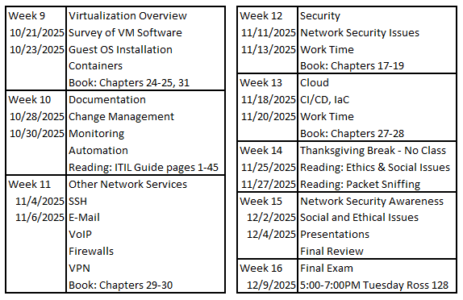
Weekly Info
Remaining Class Schedule

Slide 5
Assignment Documentation Expectations
Documentation expectations examples:
  Edit the network configuration file /etc/sysconfig/network-scripts/ifcfg-bond0
    Updated the following information in the network configuration file:
      IPADDR=147.64.243.115
      HOSTMASK=255.255.254.0
      DNS1=147.64.242.100
      DNS2=147.64.242.101
  Restarted the network services to apply configuration changes
      systemctl restart network
  Added entry to /etc/fstab file for persistent mount
    147.64.243.110:/data /data nfs bg,rw,sync,hard,intr 0 0
  Updated and rebooted the system
      dnf –y update; reboot
  Any additional descriptions that may be helpful!

Slide 6
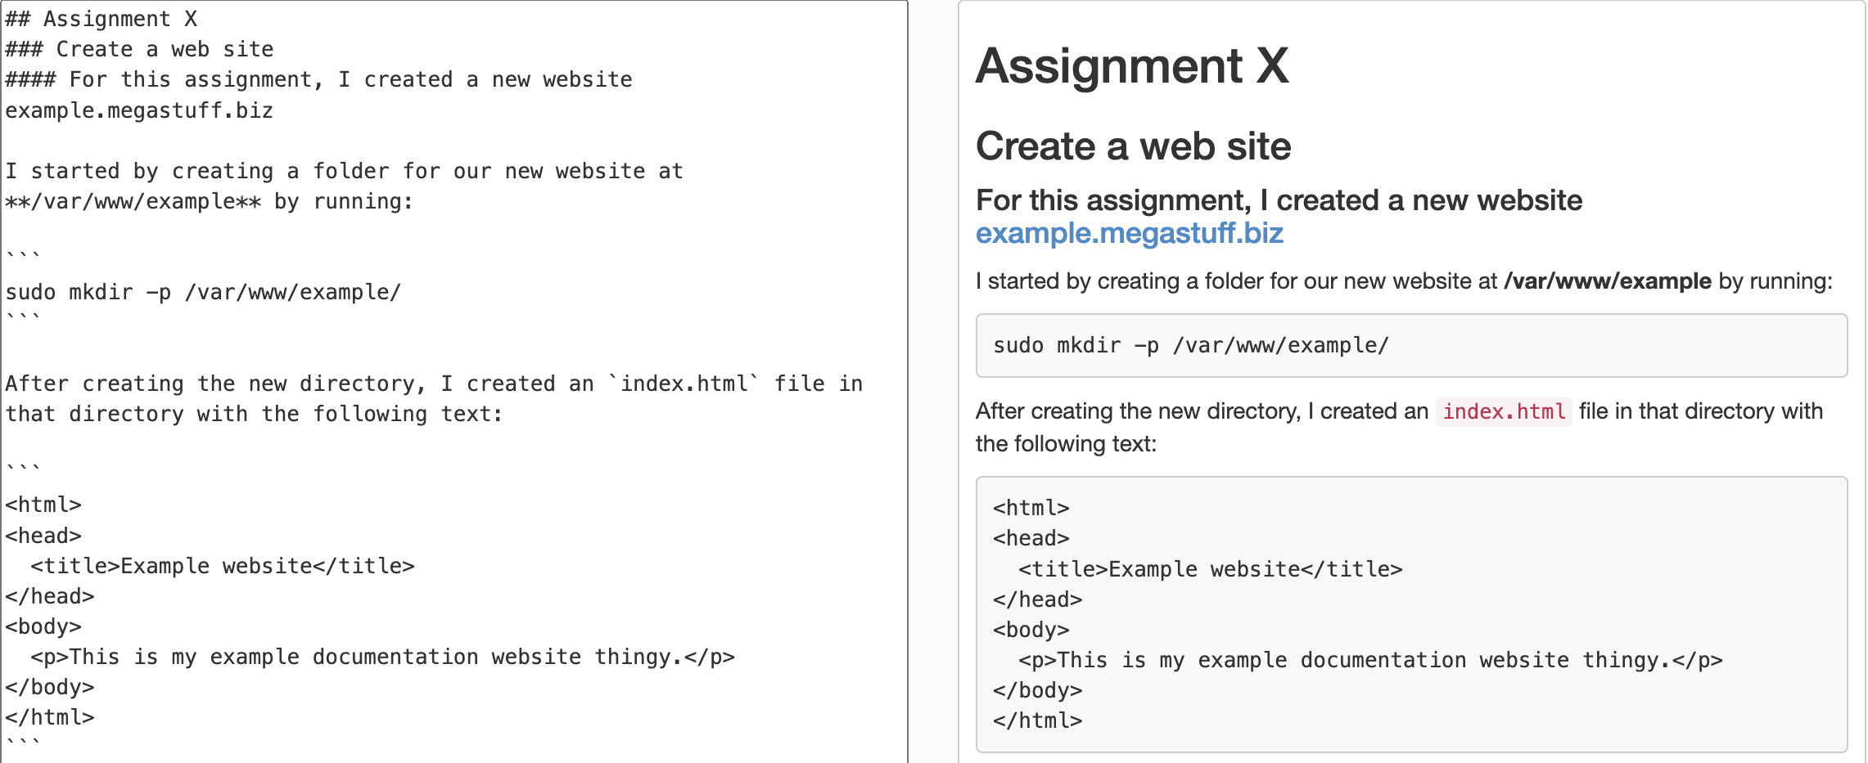
Documentation Options…
Markdown!

Slide 7

Project
Provide a report and presentation on your chosen topic
Your report and presentation should contain the following:
  Describe the standard definitions and terms
  Walk through the history of the technology
  Walk through what software/hardware you used and how
  Documentation, description of services, implementation guide, etc.
  References!
Presentation
  5-10 minute discussion of your report
  Basic implementation – How did you install?
    Documentation of steps that can be given to a junior admin!
    PowerPoint or another presentation showing steps with pictures will help!
    Live examples where possible!
Basic Report Specs
10-12 point font
1.15-1.5 line spacing
0.5-1.0 inch margins
3+ Sources

Slide 8

Network Interfaces – nmcli con show
Before assignment 4
  enp1s0, enp8s0, enp9s0, enp10s0, lo
After assignment 4
  enp1s0, enp8s0, enp9s0, enp10s0, lo
  bond-slave-enp1s0, bond-slave-enp8s0, bond-mybond0
After assignment 10?
  enp1s0, enp8s0, enp9s0, enp10s0, lo
  bond-slave-enp1s0, bond-slave-enp8s0, bond-mybond0
  bond-mybond0.110, bond-mybond0.187 , bond-mybond0.6
lo!
Docker0?!

Slide 9
Network Interfaces – ifconfig
enp1s0: flags=6211<UP,BROADCAST,RUNNING,SLAVE,MULTICAST> mtu 1500
enp8s0: flags=6211<UP,BROADCAST,RUNNING,SLAVE,MULTICAST> mtu 1500
enp9s0: flags=4163<UP,BROADCAST,RUNNING,MULTICAST> mtu 1500
enp10s0: flags=4163<UP,BROADCAST,RUNNING,MULTICAST> mtu 1500
mybond0: flags=5187<UP,BROADCAST,RUNNING,MASTER,MULTICAST> mtu 1500
inet 147.64.243.1## netmask 255.255.254.0 broadcast 147.64.243.255
mybond0.6: flags=4163<UP,BROADCAST,RUNNING,MULTICAST> mtu 1500
inet6 fd06:1234:5678:beef:110::1 prefixlen 64 scopeid 0x0<global>
mybond0.110: flags=4163<UP,BROADCAST,RUNNING,MULTICAST> mtu 1500
inet 10.11.110.1## netmask 255.255.255.255 broadcast 0.0.0.0
mybond0.187: flags=4163<UP,BROADCAST,RUNNING,MULTICAST> mtu 1500
inet 10.0.187.110 netmask 255.255.255.0 broadcast 10.0.187.255
lo: flags=73<UP,LOOPBACK,RUNNING> mtu 65536
inet 127.0.0.1 netmask 255.0.0.0

Slide 10
Network Interfaces – ip addr show
enp1s0: <BROADCAST,MULTICAST,SLAVE,UP,LOWER_UP> mtu 1500 qdisc fq_codel master mybond0 state UP group default qlen 1000
enp8s0: <BROADCAST,MULTICAST,SLAVE,UP,LOWER_UP> mtu 1500 qdisc fq_codel master mybond0 state UP group default qlen 1000
enp9s0: <BROADCAST,MULTICAST,UP,LOWER_UP> mtu 1500 qdisc fq_codel state UP group default qlen 1000
enp10s0: <BROADCAST,MULTICAST,UP,LOWER_UP> mtu 1500 qdisc fq_codel state UP group default qlen 1000
mybond0: <BROADCAST,MULTICAST,MASTER,UP,LOWER_UP> mtu 1500 qdisc noqueue state UP group default qlen 1000
inet 147.64.243.1##/23 brd 147.64.243.255 scope global noprefixroute mybond0
inet 147.64.243.1##+50/23 brd 147.64.243.255 scope global secondary noprefixroute mybond0
mybond0.6: <BROADCAST,MULTICAST,UP,LOWER_UP> mtu 1500 qdisc noqueue state UP group default qlen 1000
inet6 fd06:1234:5678:beef:1##::1/64 scope global noprefixroute
mybond0.110: <BROADCAST,MULTICAST,UP,LOWER_UP> mtu 1500 qdisc noqueue state UP group default qlen 1000
inet 10.11.110.1##/32 scope global noprefixroute mybond0.110
mybond0.187: <BROADCAST,MULTICAST,UP,LOWER_UP> mtu 1500 qdisc noqueue state UP group default qlen 1000
inet 10.0.187.110/24 brd 10.0.187.255 scope global noprefixroute mybond0.187
lo: <LOOPBACK,UP,LOWER_UP> mtu 65536 qdisc noqueue state UNKNOWN group default qlen 1000
inet 127.0.0.1/8 scope host lo

Slide 11
Network Interfaces
Assignments 1-9
Switches A & B: Public network, internet
enp1s0: Ethernet interface to switch A (port 1?)
enp8s0: Ethernet interface to switch B (port 1?)
mybond0: Fault tolerant connection to public net with additional IPv4 VIP addresses
mybond0.6: VLAN 6 on mybond 0 interface, IPv6
mybond0.110: VLAN 110 on mybond 0 interface
mybond0.187: VLAN 187 on mybond 0 interface
Assignments 10+
Switches C & D: Private network, no internet
enp9s0: Ethernet interface to switch C (port 1?)
enp10s0: Ethernet interface to switch D (port 1?)
mybond1: Fault tolerant connection to private net with additional IPv4 VIP addresses
mybond1.425: VLAN 425 on Bond 1 interface
More…
Virtual Switch!

Slide 12
DNS Addresses
SOA 41##.megastuff.biz. Admin41##.megastuff.biz. (2018090103 21600 600 1209600 10800)
NS 41##.megastuff.biz.
A 147.64.243.1##
www CNAME 41##.megastuff.biz.
private1 A 10.0.187.# (1-15 – no leading zeros!)
private2 A 10.10.1##.1
ipv6 AAAA fd06:1234:5678:beef:01##:0000:0000:0001
new1? A 192.168.0.1##
new2? A 192.168.1.1##
new3? AAAA fd06:8765:4321:face:01##:0000:0000:0001
new4? TXT Words.
new5? CNAME new1?

Slide 13


Let’s make some changes!
Reconfigure our Apache installation to use port 8080 instead of port 80
  We will use port 80 for something else!
  Only one thing can use a specific IP/port/protocol combination at a time!
    We want to use port 80/TCP for something else!
  Edit the file /usr/local/apache2/conf/httpd.conf
    Look for the lines that start with “Listen”
    Change port 80 to port 8080
      Listen 147.64.243.1##:8080
      Listen 10.0.187.##:8080
      Listen 8080
    Restart Apache!
      /usr/local/apache2/bin/apachectl restart

Slide 14
Let’s make some changes!
Reconfigure our Apache installation to use port 8080 instead of port 80
  Don’t forget about the firewall ports!
    We should already have port 80 open, but we now need port 8080 as well!
    firewall-cmd --add-port=8080/tcp
    firewall-cmd --add-port=8080/tcp --permanent
    Validate!
      HTTPD using port 8080:
        netstat -anlpt | grep LISTEN | grep :80
      Firewall port 8080/tcp (and 80/tcp) open:
        firewall-cmd --list-ports

Slide 15
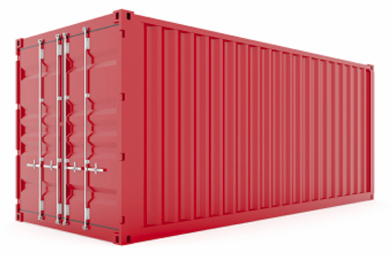
Containers
Virtualization-like techniques that provide isolated run-time environments for applications
Provide only the minimum set of requirements necessary
  Increases portability
  Contrast to full VM’s that aim to virtualize almost every aspect of a system
Many variations of container-like systems over the years
  Linux/Unix chroot
  Solaris Zones
  FreeBSD Jails
  Docker
Wrap a piece of software in a complete filesystem that contains
everything needed to run: code, runtime, system tools, system libraries
  Guarantees the software will always run the same, regardless of environment

Slide 16
Containers
Containers share the same OS kernel
Containers start instantly and use less RAM.
Container images are constructed from layered filesystems and share common files
  Reduces disk usage and makes downloads more efficient.
Containers can create additional security
  Isolate containers from each other and from the host
Containers are standardized to be as portable as possible

Slide 17
Containers
What make containers different from VM’s
  Don’t need an entire operating system
  Host OS and application container must be similar
    Ubuntu container on CentOS host
  Minimal resource requirement
  May be less secure than VM’s; may require extra configuration
  Relies on the host systems kernel
    Each VM would typically have its own kernel
  Does not need a hypervisor
  Faster creation and startup times
    Common set of tools to manage containers

Slide 18

Containers
Docker – A set of tools and interfaces used for developing, managing, shipping, and running applications
  Docker uses the libcontainer library namespaces and control groups to manage isolation and resources
  Docker images are the read-only blueprints used to build containers
  Docker containers are the actual images containing the running applications
  A Docker registry contains pre-created images
    https://hub.docker.com
  Docker hosts are the systems running Docker containers
  Docker daemon is the actual process or service managing the containers
  The Docker client consists of tools and applications to manipulate containers
  A Dockerfile is a type of configuration file used to assemble Docker images

Slide 19
Containers
Docker – A set of tools and interfaces used for developing, managing, shipping, and running applications
  Docker commands:
    Command Description
    docker attach Attach local standard input, output, and error streams to a running container
    docker build Build an image from a Dockerfile
    docker builder Manage builds
    docker checkpoint Manage checkpoints
    docker commit Create a new image from a container’s changes
    docker config Manage Docker configs
    docker container Manage containers
    docker context Manage contexts
    docker cp Copy files/folders between a container and the local filesystem
    docker create Create a new container
    docker diff Inspect changes to files or directories on a container’s filesystem
    docker events Get real time events from the server
    docker exec Run a command in a running container
    docker export Export a container’s filesystem as a tar archive

Slide 20
Containers
Docker – A set of tools and interfaces used for developing, managing, shipping, and running applications
  Docker commands:
    Command Description
    docker history Show the history of an image
    docker image Manage images
    docker images List images
    docker import Import the contents from a tarball to create a filesystem image
    docker info Display system-wide information
    docker inspect Return low-level information on Docker objects
    docker kill Kill one or more running containers
    docker load Load an image from a tar archive or STDIN
    docker login Log in to a Docker registry
    docker logout Log out from a Docker registry
    docker logs Fetch the logs of a container
    docker manifest Manage Docker image manifests and manifest lists
    docker network Manage networks
    docker node Manage Swarm nodes

Slide 21
Containers
Docker – A set of tools and interfaces used for developing, managing, shipping, and running applications
  Docker commands:
    Command Description
    docker pause Pause all processes within one or more containers
    docker plugin Manage plugins
    docker port List port mappings or a specific mapping for the container
    docker ps List containers
    docker pull Pull an image or a repository from a registry
    docker push Push an image or a repository to a registry
    docker rename Rename a container
    docker restart Restart one or more containers
    docker rm Remove one or more containers
    docker rmi Remove one or more images
    docker run Run a command in a new container
    docker save Save one or more images to a tar archive (streamed to STDOUT by default)
    docker search Search the Docker Hub for images
    docker secret Manage Docker secrets

Slide 22
Containers
Docker – A set of tools and interfaces used for developing, managing, shipping, and running applications
  Docker commands:
    Command Description
    docker service Manage services
    docker start Start one or more stopped containers
    docker stats Display a live stream of container(s) resource usage statistics
    docker stop Stop one or more running containers
    docker swarm Manage Swarm
    docker system Manage Docker
    docker tag Create a tag TARGET_IMAGE that refers to SOURCE_IMAGE
    docker top Display the running processes of a container
    docker trust Manage trust on Docker images
    docker unpause Unpause all processes within one or more containers
    docker update Update configuration of one or more containers
    docker version Show the Docker version information
    docker volume Manage volumes
    docker wait Block until one or more containers stop, then print their exit codes

Slide 23

Containers
Docker Installation
  Install Docker and necessary prerequisites
    dnf –y install docker
  Start and enable Docker service – not needed!
    systemctl enable docker --now
  Search for Docker images
    docker search httpd
    docker search mariadb
  Download a Docker image (use docker.io repository!)
    docker pull httpd
    docker pull mariadb
    docker pull mariadb:10.8.2
  Show downloaded Docker images
    docker images

Slide 24
Containers
Docker Installation
  Enable ipv4 forwarding for our docker containers!
    Check the current ipv4 forwarding setting
      sysctl -a | grep ^net.ipv4.ip_forward
    Edit the file /etc/sysctl.conf and add net.ipv4.ip_forward=1
    Apply these new settings with the sysctl -p command
    Check the current ipv4 forwarding setting again! (sysctl -a | grep ^net.ipv4.ip_forward)

Slide 25
Containers
Docker Installation
  Run our downloaded Docker container
    docker run --net=host --name=httpd_1 --restart=always -p 80:80 -d httpd
    docker run --restart=always -e MYSQL_ROOT_PASSWORD=cmac3990 -e MYSQL_USER=user -e MYSQL_PASSWORD=userpass -e MYSQL_DATABASE=test_db --name=mariadb_1 -d mariadb:10.8.2
      --net specifies the network we want to use for our container (host network)
      --name creates a descriptive name for the container
      -p hport:cport maps the ports on the host to ports on the container
      -d specifies to run the container in the background as a daemon (service)
      -e allows for the creation of environment variables within the container
  Restart a Docker container
    docker restart httpd_1
  Verify that our containers are running
    docker ps

Slide 26
Containers
Docker Installation
  Open firewall port for our httpd container (we already did this!)
    firewall-cmd --add-service=http
    firewall-cmd --add-service=http --permanent
  Create a new index file on the container
    echo "Hello CMAC3990! This is Docker." > /tmp/index.html
    docker cp /tmp/index.html httpd_1:/usr/local/apache2/htdocs/
  Connect to our new webserver
    http://147.64.243.1## (01-15)
    It works!
  Enter a docker container
    docker exec -it httpd_1 bash
    This is inside the running container, it is missing many commands!
      Exit the container with the exit command
Don’t forget TCP port 8080!

Slide 27
Containers
Docker Installation
  Stop a Docker container
    docker stop httpd_1
  Delete a Docker container
    docker rm httpd_1
  There are many more Docker options available…
  If you are having issues with your httpd_1 docker container, make sure
  your Apache install is NOT using port 80!
    /usr/local/apache2/conf/httpd.conf – Listen 8080!
      You will need to restart apache after this (or restart your server)!
Containers and clouds are all the rage!

Slide 28

Documentation
Keeping records of where things are, explaining how to do things, and making useful information available to customers.
  Documentation can be difficult!
  Document common tasks to increase efficiency
  Document disliked tasks, to delegate easier!
  Document your time, so you can see where you spend it!
  Documentation is a way to create an institutional memory of information
  allowing for a workforce with an increased knowledge and skill set
  Documentation allows people to change positions or
  take on new assignments
  A lack of documentation can push admins into being
  “in the middle of everything”
  Some people worry about the reasons for creating documentation…

Slide 29
Documentation
What to document?
  Things that are complicated or unpleasant
    Some processes may have many steps performed by different teams, each step should be documented!
    Ex: Building a database cluster
      Redundant design
      Network provisioning and configuration
      Server installation & maintenance
      Additional system software
      Database configuration & maintenance
  Things that are repeated often
    VPN/Remote access
    New user creation
    New VM deployment
  Standardization!

Slide 30
Documentation
Getting started can be the hardest part!
Four keys for getting started:
  Title – Something simple that others will understand
  Metadata (info) – Author, contact info, version, sources
  What – A few sentences describing the contents of the document,
  the scope of the document, the purpose or outcome of the document
  How – The detailed steps to accomplish the goal
    Instructions of commands used, screenshots of relevant windows, etc.
  Optionally, add additional elements
    Why – Reasoning behind some of the tasks
    Summary – Something a layman could read and understand
    Overview – Quick guide of steps with short reasoning's if necessary
Make sure to test your documentation for bugs!

Slide 31
Documentation
Learn how to use screen capturing software
  Most modern operating systems can take screenshots with the PrintScreen button
  MS Paint (or similar) can be used to quickly crop out unnecessary information
  Additional software can actually take recordings of you using the computer
The unix command script can capture commands to file
  Can be useful for recording the steps of an installation
  Script writes to a file
  Records commands ran and output
  Usage: script file.txt
The history command can also show what commands were entered
  See what commands were entered last

Slide 32
Documentation
Use Email (wisely!)
  Email conversations may contain many parts of documentation
  Can be easily searchable by the owner
  Not exactly easy to share
    You can easily forward email and share with others, but you must perform the action!
    Not available if you aren’t around to forward
  Multiple emails can contain great source information
  Emails can last forever…
Ticketing system
  You can potentially pull useful information from tickets
  System can integrate with a knowledge base
  Other various similar systems
  Ex: Jira, ServiceNOW, Solar Winds…

Slide 33
Documentation
Create checklists for multi-step tasks
  New user creation
    Email, PC, phone, account login, etc.
  Employee termination
  Server builds
  Data archiving
Checklists can be used instead of or along with
more detailed documentation
  Condensed version of only necessary steps and information
  List referring to more involved documentation
Checklists can add accountability
  If someone must sign a checklist, they will be more likely to ensure
  all the tasks were performed

Slide 34
Documentation
Storage Repository
  A centralized location
  Backups
  Version/revision/source control
  Document check-in and check-out
  Creates learning opportunities
  Organization hierarchy
  Templates
Network locations or shared folders can serve as a budget location
  Better than nothing!
  Lacking advanced features
  Easy to use, easy to access

Slide 35
Documentation
Wiki Systems
  A web-based publishing and collaboration tool and repository
  Create multi-media web pages accessible by any web browser
    Create rich HTML pages with notes, instructions, and images
  Built-in revision history
    Source control
    Check-in and check-out
  User authentication
    Single Sign On
    Groups and permissions
  Easy to edit
    Anyone can edit any page, all changes are tracked
  Linking to other documents
  Indexes, table of contents, placeholders

Slide 36
Documentation
Searchable repository
  Being able to search can help find information quickly
  Search appliances
Rollout considerations
  Get buy-in from those who will be using the system
  Fit current documentation processes into new systems
  Promote new features
Site management and upkeep
  Single person that maintains site?
  Archiving and removal of unnecessary or deprecated information
  Appropriate level of control…

Slide 37
Documentation
Dynamic Documentation Repository
  Living documentation
  Documents are updated periodically
  Promotes customer interaction
    Users can add clarification
  Wikipedia is a perfect example
Different repositories for different tasks
  Customer support documentation repository
  Source code documentation repository
  Internal support documentation repository
  Links between repositories if necessary
  Difficult to maintain multiple sites
  No one-size-fits-all

Slide 38
Documentation
Content Management System (CMS)
  A publication system for web sites
  System controls release of information at appropriate time
  Functionality can be extended with add-ons
  Repository Layer
    Generally a database or structured data with metadata
    Content stored in repository layer
  History Layer
    Implements version control, permissions, audit trails, unique document IDs, etc.
  Presentation Layer
    The user interface
    Allows browsing, editing, linking
    Interface for controlling permissions
  Drupal, MediaWiki

Slide 39
Documentation
Some level of control is necessary
  You don’t want just anybody editing your documentation
  Allowing for comments can provide for “unauthorized edits”
    Something the original author missed
    New methods of performing tasks
    Updated company related information
Structure of data
  Organization of data is important, but having documentation is key!
  Don’t impose too much structure at first
  Get buy-In! Create a low barrier to entry
  Structure will change and can always be altered as necessary

Slide 40
Documentation
Self-help desk
  Documentation for customers to find solutions
  News of upcoming maintenance
  Links to related policies and procedures
  License info, outage info, usage info
Internal group specific documents
  Documents specific to one area
  Replaces “tribal knowledge”
How-to documents
  Series of documents on specific tasks
Frequently Asked Questions (FAQs)
  May point to how-to or other documents for answers

Slide 41
Documentation
Reference lists
  Acronyms (corporate, technical, etc)
  Vendors and contact information
  Serial numbers and hardware asset tags
  License keys and software seat information
  Compatibility lists
  Employee information
  List of local information
    Hotels, take-out, taxi, visitor information, etc.
  Notification lists
Procedures and related information
  ISO standards, OSHA regulations, SOX compliance

Slide 42
Documentation
IT Information Library (ITIL)
  Set of IT service management practices
  Strategy
    Ensure services can be offered to customers
    Financial management
  Design
    Guidance on design of services
    Catalog management
    Service level management (SLA)
    Availability (99.999% uptime)
    Capacity
    Security
  Transition
    Change management, release management, deployment management
    Asset management

Slide 43
CMAC 3990.200
Systems Administration and Operations
Fall 2025 – Week 9.2 – October 23rd, 2025
Documentation, Change Management, Monitoring, ITIL…

Slide 44

Documentation
IT Information Library (ITIL)
  Set of IT service management practices
  Operation
    Maintain functional services
    Service desk, application management, IT operations
    Incident & event management, root cause analysis
  Continual Improvement
    Update information
  ITIL v3 Guide
    https://jpatalon.cs.edinboro.edu/cmac3990/ITIL%20v3%20Guide.pdf

Slide 45
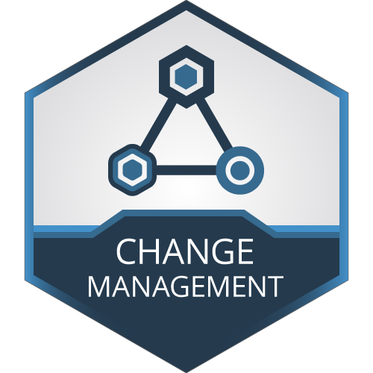
Change Management
The process of ensuring effective planning, implementation, and analysis of changes made to a system.
Changes made can risk system outages
Change management assesses risk and manages with mitigation strategies
Changes should include:
  Planning for the change
  Communication of the change
  Scheduling of the change
  A test plan of changes
  A back-out plan
Communication of changes is key!

Slide 46
Change Management
Four primary components of change management related to system administration
  Communication and scheduling
    Communicate with the customers and other admins, so everyone knows what is happening,
    and change tasks are scheduled at an appropriate time, not to interfere with other work
  Planning and testing
    Plan the change tasks ahead of time
    Plan the success criteria ahead of time – how to test for a successful change
    Plan the back-out strategy ahead of time – what to do if the change doesn’t work
  Process and documentation
    Follow a standard process
    Documentation must be approved prior to changes
  Revision control and automation
    Automate tasks that can be automated, ensuring reliability and consistency
    Revision control can track changes and assist in backing out changes

Slide 47
Change Management
Take in to account the different types of systems, and different types of changes
  Desktops, laptops, servers
  Major, minor, emergency
  Access, software, hardware, security
Minor changes may be less restrictive
  Fewer approvals
  Less impact, lower risk
Significant changes may be more restrictive
  Additional paperwork
  Senior team member consultation/oversight
  Involved test procedures and back out plans
  User validation
  Advanced communication and notification

Slide 48
Change Management
Manage different types of risk with appropriate effort
Quantify the risk!
  What is going to be impacted?
  What is most likely to happen?
  What is the worst that could happen?
  Who would notice an outage?
  Create profiles for items and categorize appropriately!
    Business critical, infrastructure, development, testing, etc.
    Make note of connections between components and impacted customers
    A good documentation system can greatly assist here!

Slide 49
Change Management
Risk mitigation
  Backups!
  Institute a Change Advisory Board (CAB)
    CAB oversees changes based on impact and risk
    Is there a (business) need?
    Is there a conflict with other changes?
    What kind of impact and risk might this have on other areas?
    When can the change be scheduled?
      Outages, maintenance windows, business hours
  Create a test plan
    How is success measured?
    What is the desired outcome?
    What are the overall steps for the change?
    Attempt to include a means to measure overall completion
      At any point, you should be able to estimate completeness and remaining time

Slide 50
Change Management
Risk mitigation
  Create a back-out plan
    How do I revert the systems to their previous state if there are problems?
    What must/can/can’t/should be backed out
  Have a decision point
    When do you back out, if things are not going as planned?
    What level of completion should be met at what point?
    Who makes the decision to back out?
    Create multiple decision points if necessary
    Drop-dead cutoff point
  Preparation and planning
    What can be done in advance?
    What can be tested in advance?
    Can another environment be used before production?
    Will the changes even be compatible? Is it best practice?

Slide 51
Change Management
Communications!
  Technical team communications
    Details of plan, timings, steps
    Identify problems faster
    Communication channels during change
  Customer or business communications
    Information about potential impacts
    Cutover to a new system?
      Details of new system!
    Change in document storage location?
    Phased cutover?
    Soft cutover?
      Old version still available
    Touch points during the change (if appropriate)
    Success/failure completion or back-out communications

Slide 52
Change Management
Communications!
  Point of contact for issues related to a change
    Project Manager, supervisor, senior employee, person on point
  Don’t send too much
  Target correct users
Scheduling
  How long will the change take?
  Approval and review time
  Bake time
  Who will be affected?
    How many, what level, secondary impact

Slide 53
Change Management
Scheduling
  What type of change?
    Routine – Can happen any time, mostly invisible, minimal risk
      Updating users in AD/LDAP system, installing a printer
    Major – Restricted available time frame
      Affect many systems, affect critical systems, impact infrastructure
      30% or more of installation base
      Highly visible to customers or business
      Off-peak outage windows
    Sensitive – Very large potential impact
      Affect a major amount of systems, impact a majority of users
      Complicated, coordinated
      Off-hours
      Additional validation
    Every business can define different change schedules

Slide 54
Change Management
Scheduling
  Outage windows
    Specific times when specific outages are acceptable
      Email system between 1:00am and 3:00am on Sunday mornings
      Third Saturday evening of the month
    Restricted times – Change freeze
      No Friday changes?!
        Fire-drill Fridays!
      Company events
      Holidays
    Preferred changes during the day?
      Outage can be tolerated
      Personnel on hand to address any potential issues
    Create guidelines!
      Documentation!

Slide 55
Change Management
Process
  Change request information
    Change proposal or control
    Describe change and reasoning
    Indicate risk
    Indicate test procedures
    Back out plan
    Timings
    Management approvals
    Notification information
    Any additional pertinent information
    Varying levels of detail depending on the type of change

Slide 56
Change Management
Documented procedures for what is a change
  What environments, what kind of change
  Details necessary before starting the change
  How to complete the change paperwork as desired
Technical aspects
  Revision history
    Documentation management systems!
    Copies of configuration files taken before changes are made
  Automated checks
    What must be working? How can it be automatically tested?
    System reboots!
  Monitor files for changes
    Automated systems to check that key files remain unchanged

Slide 57
Change Management
Frequent change management meetings
  Review and discuss upcoming changes
  Scheduling proposed changes; preventing scheduling conflicts
  Ensure a conversation happens regarding the changes
  Raise awareness
  Reduces outages
  Increases customer satisfaction
  CYA!
  Increased ability to identify problems
  Not too frequent!
Continual improvement
  Reduce redundant tasks?!

Slide 58
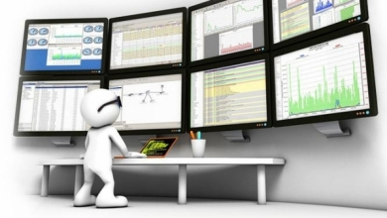
Monitoring
If you aren’t monitoring it, you aren’t managing it.
Real-time and historical monitoring
Identify and correct problems before they occur
  Disk space monitoring; disk usage projections
Identify usage trends
  Identify “quiet” times well suited for maintenance
Can be resource intensive
  Network bandwidth, data storage, data processing
  Monitoring agent process usage on host
Can pull data from hosts, or push data to centralized server
  Push or Pull

Slide 59
Monitoring
Multiple means of measuring hosts
  Pings
  SNMP service calls
  Standalone software agent
  SSH calls
  Web calls
Notifications
  Runway length
  Warning, critical, informational messages
Security
  Not everyone should be able to see critical data!
  Monitoring systems/sources traditionally are insecure

Slide 60
Monitoring
Escalation mechanisms
  Critical or emergency alerts may need to include management and a wider audience
  Production should receive higher priority than non-production
Active monitoring systems
  Processes that try to automatically address/repair issues
  Increased risk?
Account access & configuration
  Polling specifications
  Monitoring system admin, user, etc.
  Custom dashboards
  Automation and discovery

Slide 61
Monitoring
End to end tests
  Testing an entire transaction from start to finish
  Identify bottlenecks in specific systems
Application response times
  Is everything running, but slow?
Scaling
  Monitoring more things requires more horsepower
Meta
  Monitor your monitoring monitor
Downdetector.com

Slide 62
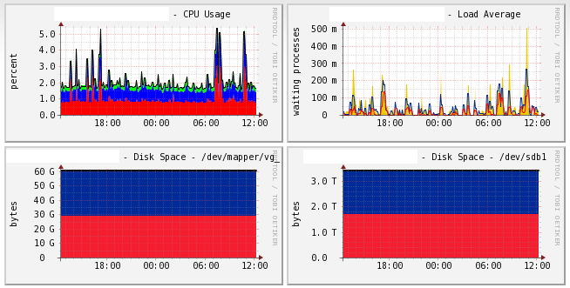
Monitoring
Examples
  Cacti - Historical

Slide 63
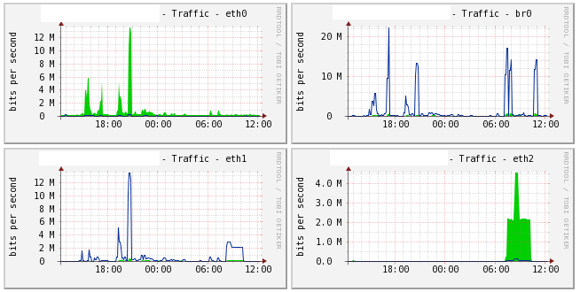
Monitoring
Examples
  Cacti - Historical

Slide 64
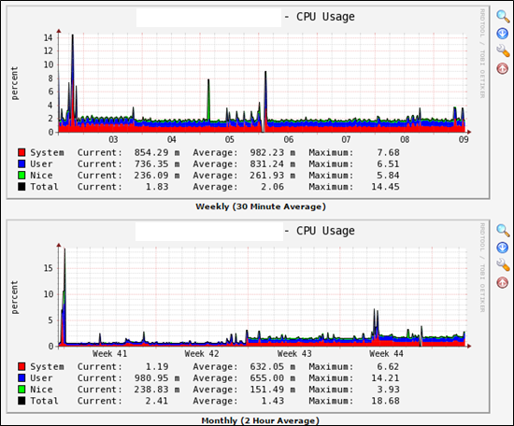
Monitoring
Examples
  Cacti - Historical

Slide 65
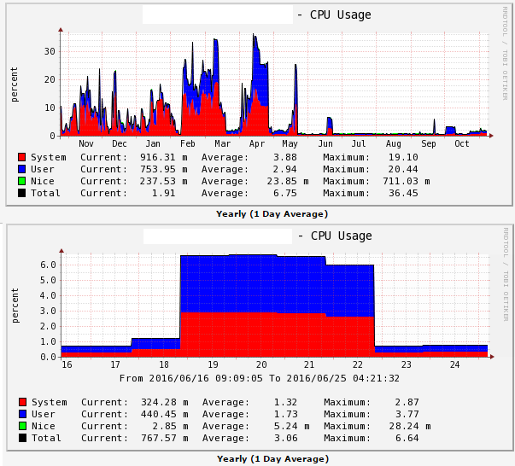
Monitoring
Examples
  Cacti - Historical

Slide 66
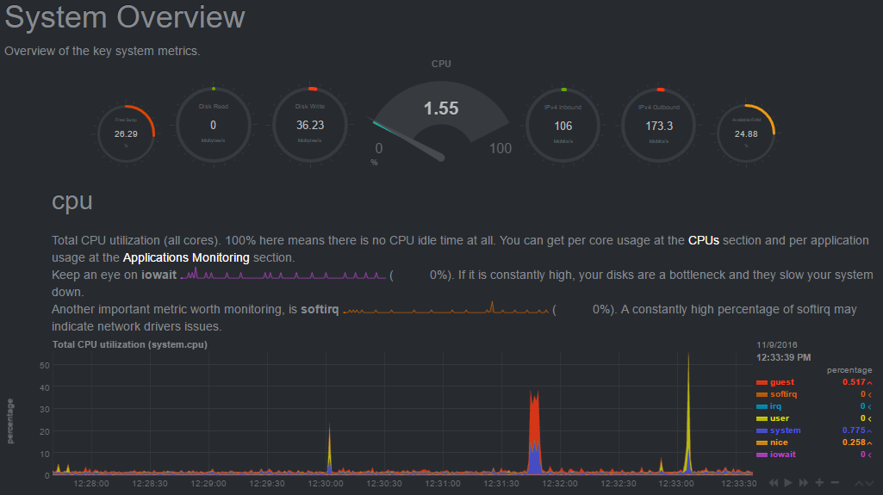
Monitoring
Examples
  Netdata – Real Time
  Already installed!
Already installed!

Slide 67

Netdata Install
Already installed!
https://github.com/netdata/netdata/wiki/Installation
Can be installed via package managers for many Linux flavors
  Packages now available via EPEL package managers for RHEL!
  dnf install netdata
Installation on any Linux flavor can be accomplished with the following command (run as root!):
  Update your system first!
  bash <(curl -Ss https://my-netdata.io/kickstart.sh)
  Follow the on screen prompts!
    Install prerequisites (if necessary)
    Install Netdata

Slide 68
Netdata Install
Already installed!
Configure Netdata
  Edit /etc/netdata/netdata.conf
    In [web] section, change bind to from localhost to your IP:
      bind to = 147.64.243.1##
        This is also new!
  Start and Enable Netdata
    systemctl enable netdata --now
  Open port 19999 in the firewall to allow traffic in!
    firewall-cmd --zone=public --add-port=19999/tcp --permanent; firewall-cmd --reload
    Firewall-cmd --list-ports
  Browse to our new Netdata installation!
    http://147.64.243.1##:19999
    University firewall will prevent direct access from off-campus
      SSH tunnel? SOCKS proxy?
        Must use SOCKS PROXY!!!

Slide 69
Monitoring
Old install process!
Netdata Install
  Real-time example website: https://my-netdata.io/
  Software installation website: https://github.com/firehol/netdata
  Prepare your system
    dnf install epel-release git
    curl -Ss 'https://raw.githubusercontent.com/firehol/netdata-demo-site/master/install-required-packages.sh' >/tmp/kickstart.sh && bash /tmp/kickstart.sh netdata-all
  Install Netdata
    cd
    git clone https://github.com/firehol/netdata.git --depth=1
    cd netdata
    ./netdata-installer.sh
  Netdata is automatically started and configured to start on boot
    systemctl status netdata

Slide 70
RPO & RTO
Recovery Point Objective (RPO)
  Recovery Point Objective limits how far to roll back in time, and defines the maximum allowable amount of data loss, measured in time from a failure occurrence to the last valid backup.
Recovery Time Objective (RTO)
  Recovery Time Objective is related to downtime and represents how long it takes to restore from the incident until normal operations are available to users

Slide 71
RPO & RTO
RPO is about how much data you afford to lose before it impacts business operations
  A banking system may operate live transactions, so a 1 hour loss of data can be significant
  In case your system crashes, the last time you saved a document you are working on
    How much of your work are you willing to lose before it affects you?
RTO is the timeframe within which application and systems must be restored after an outage
  Measure the RTO starting with the moment the outage occurs - This is a more realistic approach
    This represents the exact point when
    the users start to be impacted.

Slide 72
Backup and Disaster Recovery Approaches
There are a few main approaches to backups and Disaster Recovery
Backup and Restore (COLD!) – Back up your data and applications from one location to another
  Backup to tape, ship tapes offsite, recover to cloud or offsite
  Backup to cloud, restore to cloud or offsite
Pilot Light – You replicate part of your IT structure for a limited set of core services so that the cloud environment can take over in the event of a disaster
  A small part of your infrastructure is always running simultaneously syncing mutable (changing) data
  Other parts of your infrastructure are switched off and used only during testing or disasters
  You must ensure that your most critical core elements
  are already configured and running in the cloud
  When the time comes for recovery, you can rapidly
  provision a full-scale production environment
  around the critical core.

Slide 73
Backup and Disaster Recovery Approaches
Warm Standby – A scaled-down version of a fully functional environment is always running
  This extends the pilot light elements and preparation
  It decreases the recovery time because some services are always running
Multi-Site (HOT!) – A multi-site solution runs on multiple sites in an active-active configuration
  The data replication method that you employ will be determined by the recovery point that you choose:
    Either Recovery Time Objective
      The maximum allowable downtime before degraded operations are restored
    Or Recovery Point Objective
      The maximum allowable time window whereby you will accept the loss of data
Clouds!

Slide 74

NFS Mount Options
Hard vs Soft mount option
  A Hard mount is typically used for block resources, like local disks or storage area networks.
    Hard mounts on network file systems can cause disk write blocking to occur when a connection is interrupted
  A Soft mount is typically used for network file resources, like NAS/NFS/CIFS.
    Soft mounts will handle network interruptions better than hard mounts, timing out and closing
Change your NFS mounts to soft instead of hard
  This will provide better NFS response if there are connection interruptions
  Edit the /etc/fstab file
    Change any NFS mount from hard to soft
      Ex: 147.64.243.110:/home/students /home/students-nfs nfs rw,sync,soft,intr 0 0

Slide 75
Linux Commands
cp
ifdown
ifup
virsh
virsh list --all
systemctl
wget
virt-install
dnf
docker
firewall-cmd
netstat
chroot
cd
git
systemctl
script
history
PrintScreen button
ping
curl
firewall-cmd
ps

Slide 76

Key Terms and Items
VM Implementations
chroot
Virtualization
  Benefits
Host
Guest
Hypervisor
Hardware emulation
Full virtualization
Paravirtualization
Containers
  Benefits

Slide 77
Key Terms and Items
ITIL
Change Management
Change Components
Types of changes
Risk mitigation steps
Back-out plan
Communication
Scheduling
Outages & Windows
Monitoring
Realtime vs. historical Monitoring
Documentation
Documentation Items
Ticketing systems
Revision control
Storage repository
Wiki systems
Content Management System (CMS)
Self-Help
How-To's
FAQ’s
Elastic Load Balancers

Slide 78
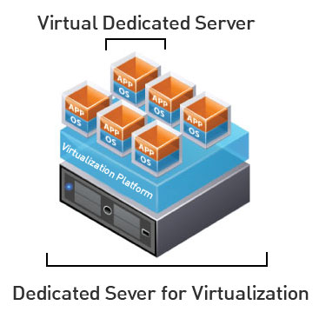
Virtual Machines
VM Info:
  IP Address: 147.64.243.1##/23 (01-20) – bond0
  Hostname: ecsc425-1##.cs.edinboro.edu (01-20)
  Alias: 41##.megastuff.biz (01-20)
  Samba: \\147.64.243.1##\ (01-20)
  Interfaces:
    Enp1s0, enp8s0, enp9s0, enp10s0, mybond0, mybond0.6, mybond0.110, mybond0.187, mybond1???
  Additional IP’s??? Future???
    mybond0 – 147.64.243.1## & 147.64.243.150+##/23
    mybond0.6 – fd06:1234:5678:beef:1##::1/64
    mybond0.110 – 10.10.1##.1/16
    mybond0.187 – 10.1.187.1##/22
    mybond1 – 192.168.1.1##/24 & 192.168.1.2##/24 & fd06:8765:4321:face:1##::1/64
    mybond1.425 – 192.168.1##.25/19

Slide 79

For Next Week
“A place for everything, everything in its place.” –Benjamin Franklin
Textbook:
  Chapter 24: Virtualization
  Chapter 25: Containers
  Chapter 31: Methodology, Policy, & Politics…
  ITIL v3 Guide pages 1-45 (https://jpatalon.cs.edinboro.edu/cmac3990/ITIL%20v3%20Guide.pdf)
Next week topics
  Documentation!
  Change management!
  Other network services!
  Cloud, VoIP, VPNs, AWS…
  Work time!

